Slide 1
J-Gate
最全面性的期刊資料庫
The Most Comprehensive Journal Database
Improve Research and Innovation
Reduce Journal Expenditure
改善搜尋與幫助創新
同時減少找尋期刊花費的時間

Slide 2
Mainstream vs Obscure Journals
There are 12,000 Publishers that publish around 55,000 Journals (english) global
總共有12,000出版社每年出版55,000筆期刊
Mainstream Publishers (Elsevier, Springer, Wiley, T&F, Sage, Emerald, etc) own around 25,000 Journals
主流大型出版社(Elsevier, Springer, Wiley, T&F, Sage, Emerald, etc)擁有約25,000筆
Obscure Publishers (very small publishers) own around 30,000 Journals
小型出版社擁有約30,000筆

Slide 3
Impact Factor (IF) 與 Scimago Journal Ranking (SJR) 是甚麼與我們該注意此事?
IF and SJR of a given Journal are calculated annually based on the total number of Citations received in that Journal
IF與SJR是用來衡量每年此期刊被引用與的指標，用來衡量期刊影響力的指標。
These are Indices developed to help determine the Popularity of a certain Journal
於是就有了許多指數可以來預估此期刊是否受歡迎。
These methods of calculation affect Publishers’ decision in the way they accept Articles (commercial publishers want to maintain or improve journal ranking)
這些計算方法導致許多出版社訂下了何種期刊可以被它們收錄(商業出版社希望可以維持或增加他們的期刊評比分數)
IF and SJR divides the Publishers into Mainstream and Non-mainstream (Obscure)
於是IF與SJR這兩項指標變將出版社分為主流出版社與非主流出版社。

Slide 4
沒有圖書館可以訂閱所有的期刊
Databases are an Essential Tool for all Researchers
資料庫對每個研究者來說都是必須的
Researchers need to rely of a number of databases to help the find Articles that support their research
研究者需要許多的資料來佐證他們的研究成果
However, most databases only index Mainstream Journals
然後多數資料庫只會將主流期刊納入索引
Coverage is just not good enough to adequately support Researchers
覆蓋範圍的資料量並不足夠支持許多研究者

Slide 5
新點子與破壞式創新從何而來?
Mainstream publishers want to protect their Journal Ranking and are hence adverse to accepting papers with unproven or unpopular ideas
大型主流出版社希望保護它的期刊評分所以不會接受未經檢驗與不夠受歡迎的想法
Breakthrough Ideas or Future Innovations are typically published in Obscure Journals first
那些創新想法與創造發明的都是先來自小型期刊

Slide 6
Innovation & Research Life Cycle
創新與研究的關係循環
Popular or Mainstream Journals
Obscure or Declining Journals
Extending
Existing Ideas
Popularity (SJR / Impact Factor)
OVER 20,000
Journals
Mainstream Databases are only interested to index Popular Journals to maintain IF or SJR
Innovation
Growth
Maturity
Decline
Notes:
It is also important to understand that Innovation and Research goes through product life cycle. This becomes an issue for big name publishers who are trying to maintain a high impact factor or SJRanking. As IF or SJR is dependent on article citations, big publishers typically will only accept papers on popular topics. As such, if a researcher is trying to publish a paper on something revolutionary or unheard of, it is likely that they can only publish with small or obscure publishers. We can see some examples in the following slides

Slide 7
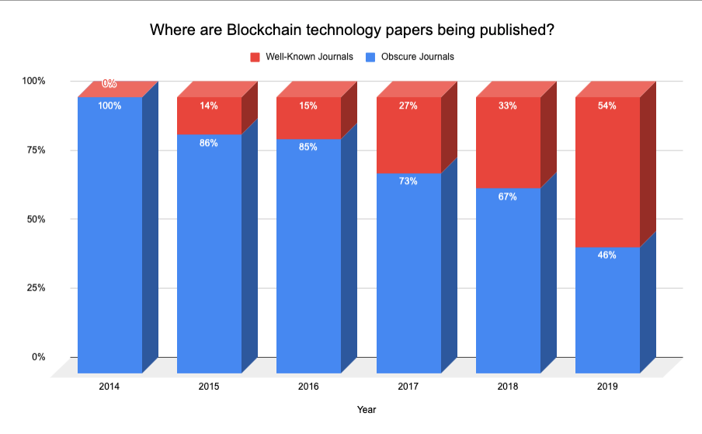
Breakthrough Ideas and Innovations are Found in Obscure Articles
創新的想法與發明都是先來自無名氣文章
Notes:
Take blockchain as an example. The blue bars refer to obscure or lesser known journals. Whereas the red bars refer to mainstream journals with IF or SJR. You notice that the mainstream publishers only take interest in a certain topic once it becomes popular.

Slide 8
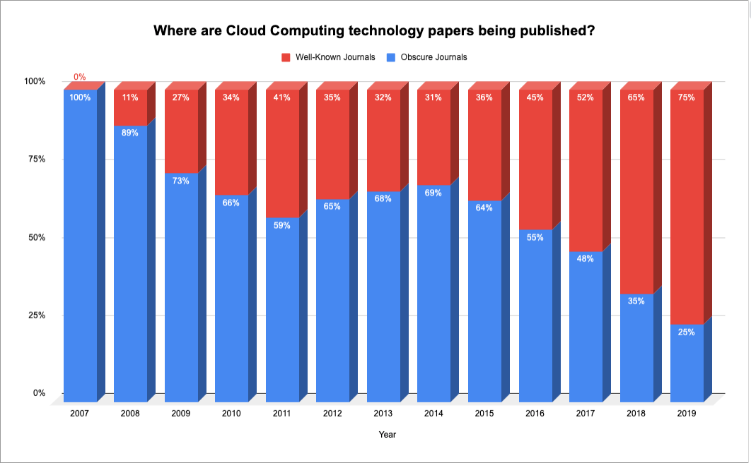
Breakthrough Ideas and Innovations are Found in Obscure Articles
創新的想法與發明都是先來自無名氣文章2
Notes:
When we look at Cloud Computing, if follows the same trend. Again, you can see that mainstream publishers will only start accepting papers on new topics once it becomes popular. This is extremely crucial for researchers because the Blue Bars represents how much data they are missing during their literature discovery phase.

Slide 9
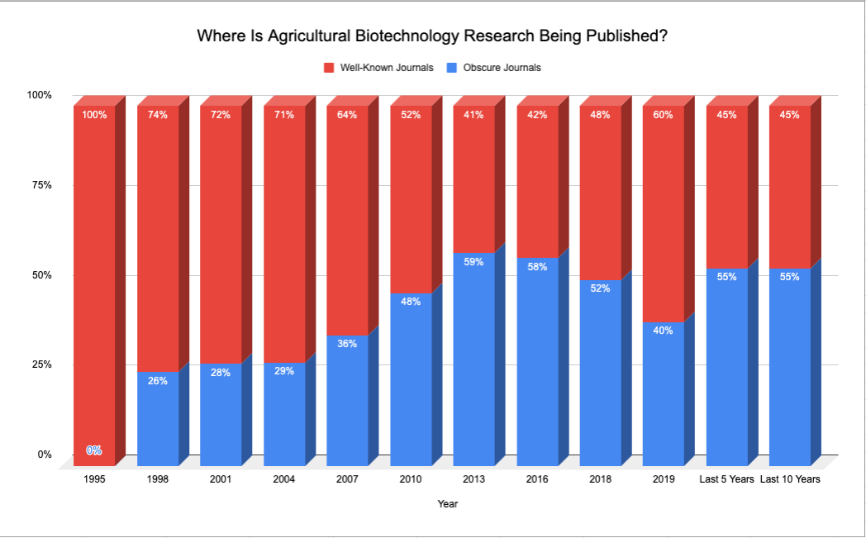
Declining Ideas and Innovations are also Found in Obscure Articles
討論度開始下滑的主題與創新都可以在不知名期刊找到
Notes:
In order to maintain a certain IF or SJR level, Mainstream publishers are also not interested to publish articles or ideas or technology that are considered to be in the Declining phase of the life cycle. You can see in the example how mainstream publishers start to cut back on publishing articles on declining technology. If a researcher is doing research in this area, they have no choice buy to look at non-popular or obscure journals to support their research.

Slide 10
然而，要做到建立龐大的期刊資料庫實在不容易
How can you Bridge the Knowledge Gap between the “Haves” and the “Have-nots”?
要如何建構一座橋梁連接”已擁有”與”未擁有”的期刊?
How can you Level the Playing Field and Stay Competitive?
那要如何讓維持競爭力與足夠的資料庫呢?
讓jGate來幫助您!

Slide 11
jGate可以立即增廣您的期刊目錄!
55,000 Academic Periodicals筆固定出版系列期刊 (25,000 OA and 8500 Hybrid)
63.5M Abstracts and Index 63,500,000的筆摘要與文章
13.5M Full Articles 13,500,000筆完整文章
10,000 Articles added daily (No Embargo) 每日加入 1萬筆文章
Fully Curated English Language Journals 經過妥善整理的英文期刊
Powerful yet easy to use Discovery platform 強大與簡易使用的介面

Slide 12
Content Sources 內容來源
(12,000+ 出版社 來自 135 個國家)
前10名期刊出版來源國 | 前10大出版社
United States 美國 United Kindom 英國 Netherlands 荷蘭 Germany 德國 India 印度 Switzerland 瑞士 Japan 日本 Australia 澳洲 Canada 加拿大 Brazil 巴西 | Elsevier Wiley Springer Nature Taylor and Francis Sage Oxford University Press American Chemical Society LWW Nature IEEE

Slide 13
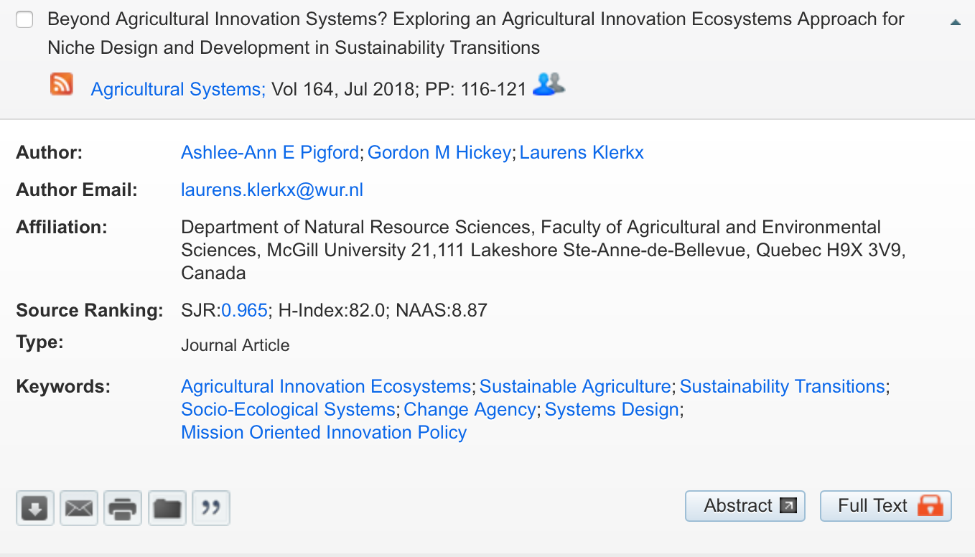
jGate幫您盡快找到您需要的期刊
Access to over 13.5M Free Articles through one Platform!
透過jGate平台閱讀超過1350萬筆免費文章
Hybrid Journals
  Over 8500 Commercial Journals contain Free Articles that are “Invisible” to the Users
  jGate’s Curation Technique Identifies these Articles and make them visible to the Users
Requests Articles directly from Authors
提供作者資料，可直接寫信聯繫作者索取!
Author Contact

Slide 14
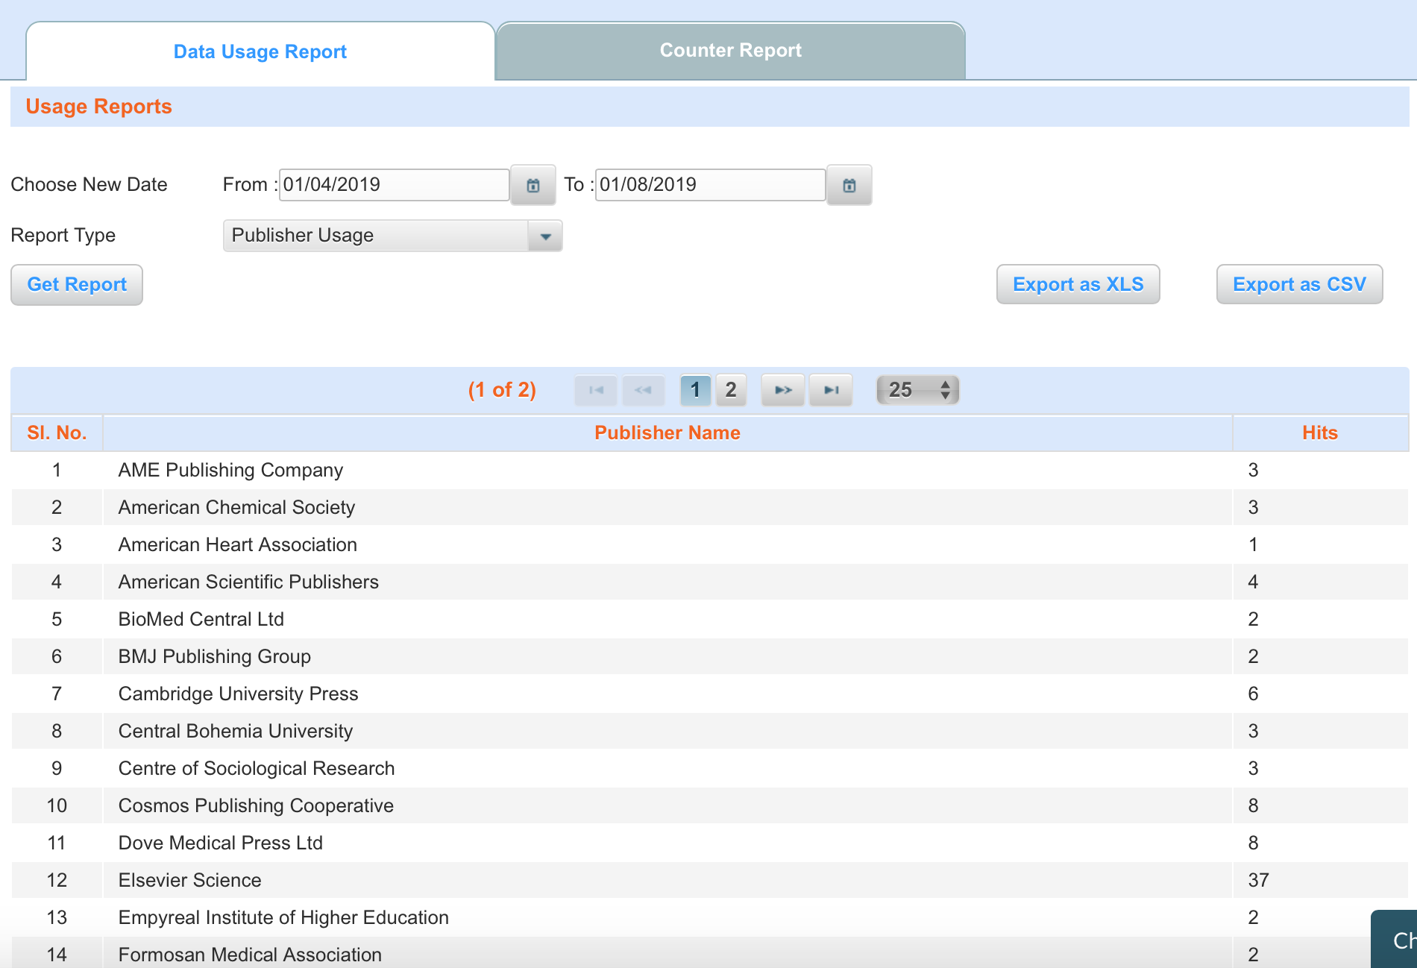
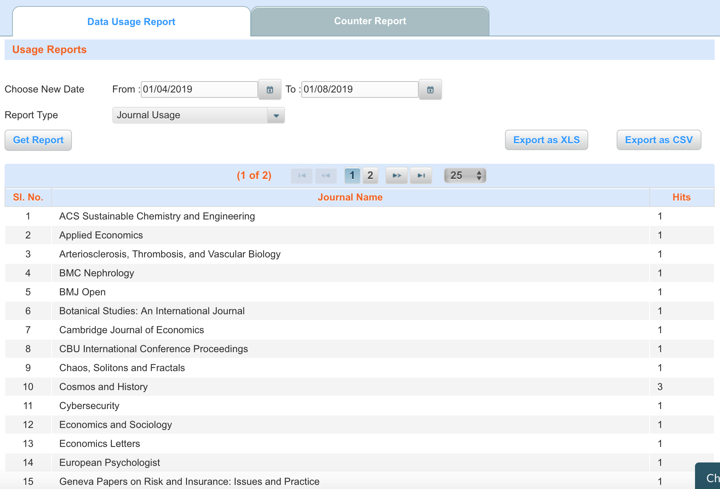
Powerful Usage Reporting Tool
有效的使用數據報告
jGate Shows you which Journal is important to Users
jGate幫您統計哪筆期刊點閱數最高!
jGate Provides One Single Report on Journal and Publisher Usage!
並提供您每月使用紀錄供您參考

Slide 15
J-Gate is a Must-have Research Tool jGate是您必須擁有的工具
Reduces Journal Expenses and Improves Research and Innovation
減少期刊花費並完善您的研究與創新

Slide 16
Summary
jGate instantly adds 55,000 Academic Periodicals to your Library’s Collection with access to 13.5M original full articles
jGate 立即幫您增加55,000系列期刊至您的收藏中與1.35千萬筆文章
jGate Can Reduce your Journal Expenditure
jGate可以減少您在期刊上的花費
jGate Consolidates Journal Usage Activities into One Report
jGate 幫您整理所有使用數據報表供您參考
jGate provides the best Journal Coverage for your Researchers across all disciplines
jGate涵蓋了各主題最完整的期刊資料
jGate Discovers more “New and Innovative” Articles compared to other mainstream databases
jGate 發掘更多新概念與創新的文章!

Slide 17
J-Gate Covers your Journal Gap and Reduces Journal Expenditure

